Slide 1


Guilherme Fernandes de Mattos
24/08/2022

Slide 2

Outline
Executive Summary
Introduction
Methodology
Results
Conclusion
Appendix

Slide 3
Executive Summary
Summary of methodologies
Summary of all results

Slide 4
Introduction
Project background and context
SpaceX advertises Falcon 9 rocket launches on its website with a cost of 62 million dollars; other providers cost upward of 165 million dollars each, much of the savings is because SpaceX can reuse the first stage. Therefore if we can determine if the first stage will land, we can determine the cost of a launch.
Problems we want to find answers
How can we determine the cost of a launch?
Can we predict which launches are going to land successfully for reuse?

Slide 5

Section 1

Slide 6
Methodology
Executive Summary
Data collection methodology:
Data have been extracted through API and web scraping and exported to csv
Perform data wrangling
Describe how data was processed
Perform exploratory data analysis (EDA) using visualization and SQL
Perform interactive visual analytics using Folium and Plotly Dash
Perform predictive analysis using classification models
How to build, tune, evaluate classification models

Slide 7
Data Collection
Data have been collected through two different ways:
API
Web Scraping
Get Raw Data
Extract and Refine to a Dataframe
Export to CSV

Slide 8
Data Collection – SpaceX API
Request on SpaceX API
Normalize Json
Extract and Refine Dataframe
Export to CSV
https://github.com/gfmattos/cr_spacey/blob/main/notebooks/s1-data-collection-api.ipynb

Slide 9
Data Collection - Scraping
Create BS Object
Parse the HTML from Wikipedia Tables
Extract and Refine Data
Export to CSV
https://github.com/gfmattos/cr_spacey/blob/main/notebooks/s1-data-collection-webscraping.ipynb

Slide 10
Data Wrangling
Due to the model which is going to be created, it was necessary to convert the values from Outcome column to a proper label called Class.
Analyze Missing Data Relevance
Create the Label Class
Export the Resultant Dataset to CSV
https://github.com/gfmattos/cr_spacey/blob/main/notebooks/s1-data-wrangling.ipynb

Slide 11
EDA with Data Visualization
Summarize what charts were plotted and why you used those charts
https://github.com/gfmattos/cr_spacey/blob/main/notebooks/s2-eda-dataviz.ipynb

Slide 12
EDA with SQL
Using bullet point format, summarize the SQL queries you performed
https://github.com/gfmattos/cr_spacey/blob/main/notebooks/s2-eda-sqllite.ipynb

Slide 13
Build an Interactive Map with Folium
Summarize what map objects such as markers, circles, lines, etc. you created and added to a folium map
Explain why you added those objects
Add the GitHub URL of your completed interactive map with Folium map, as an external reference and peer-review purpose
https://github.com/gfmattos/cr_spacey/blob/main/notebooks/s3-folium-analysis.ipynb

Slide 14
Build a Dashboard with Plotly Dash
Summarize what plots/graphs and interactions you have added to a dashboard
Explain why you added those plots and interactions
https://github.com/gfmattos/cr_spacey/blob/main/notebooks/s3-folium-analysis.ipynb

Slide 15
Predictive Analysis (Classification)
Summarize how you built, evaluated, improved, and found the best performing classification model
You need present your model development process using key phrases and flowchart
https://github.com/gfmattos/cr_spacey/blob/main/notebooks/s4-prediction.ipynb

Slide 16
Results
Exploratory data analysis results
Interactive analytics demo in screenshots
Predictive analysis results

Slide 17

Section 2

Slide 18
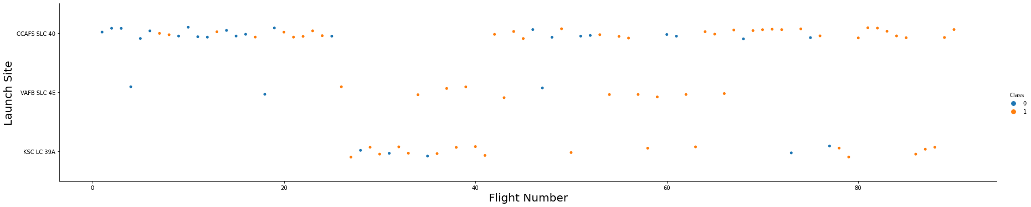
Flight Number vs. Launch Site

Slide 19
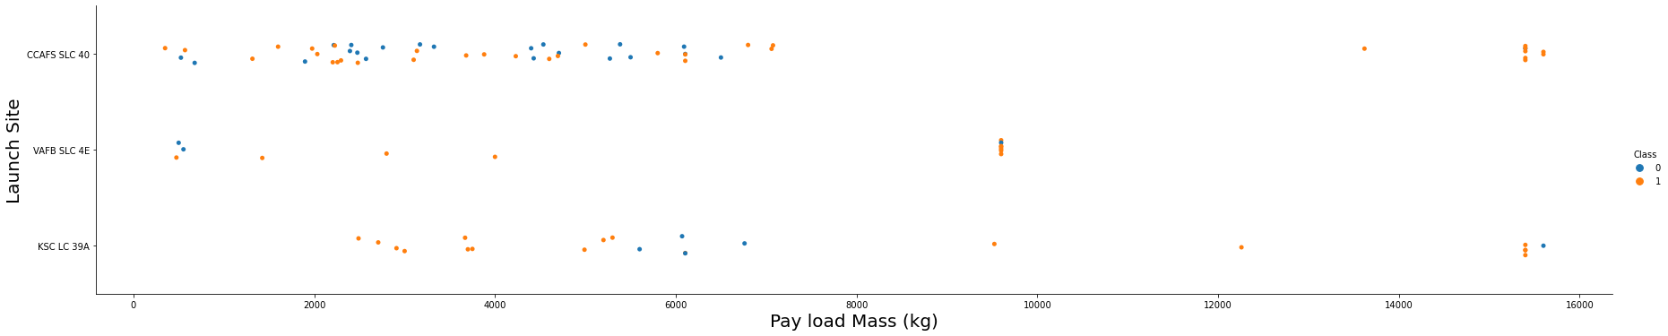
Payload vs. Launch Site
VAFB-SLC launchsite there are no rockets launched for heavypayload mass(greater than 10000).

Slide 20
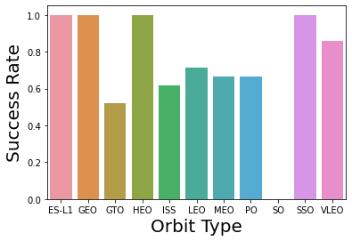
Success Rate vs. Orbit Type

Slide 21
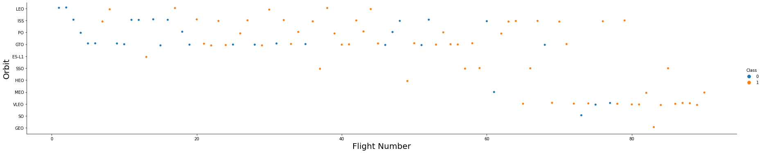
Flight Number vs. Orbit Type
You should see that in the LEO orbit the Success appears related to the number of flights; on the other hand, there seems to be no relationship between flight number when in GTO orbit.

Slide 22
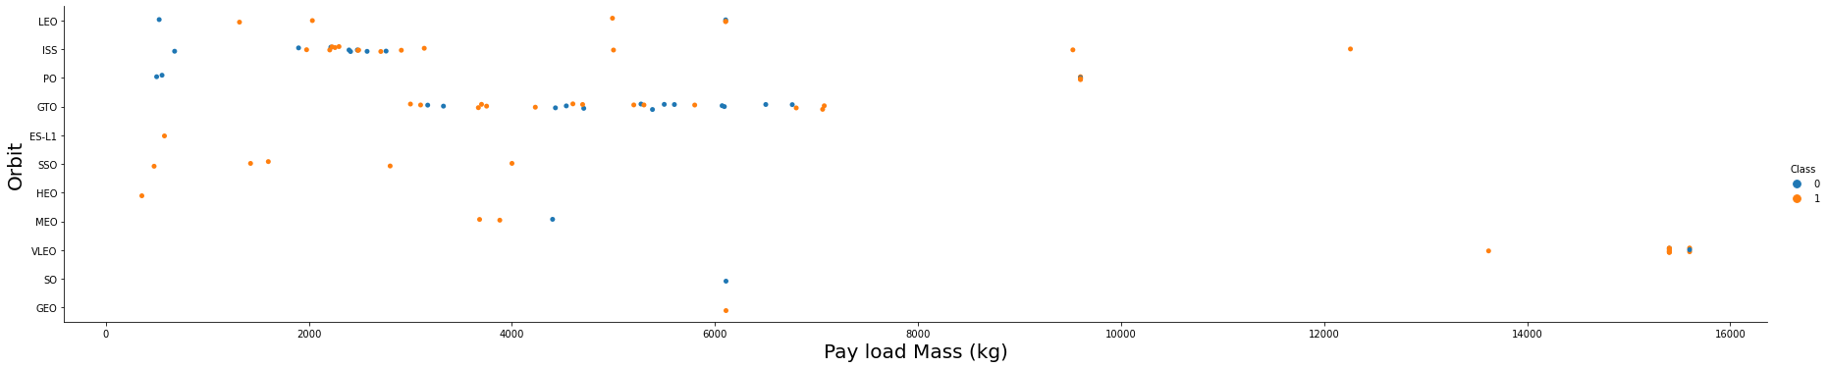
Payload vs. Orbit Type
With heavy payloads the successful landing or positive landing rate are more for Polar,LEO and ISS.
However for GTO we cannot distinguish this well as both positive landing rate and negative landing(unsuccessful mission) are both there here.

Slide 23
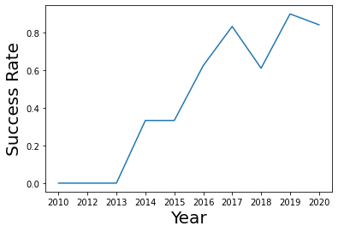
Launch Success Yearly Trend
you can observe that the sucess rate since 2013 kept increasing till 2020

Slide 24
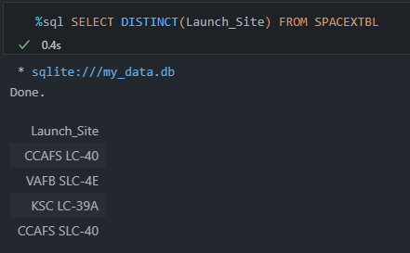
All Launch Site Names

Slide 25
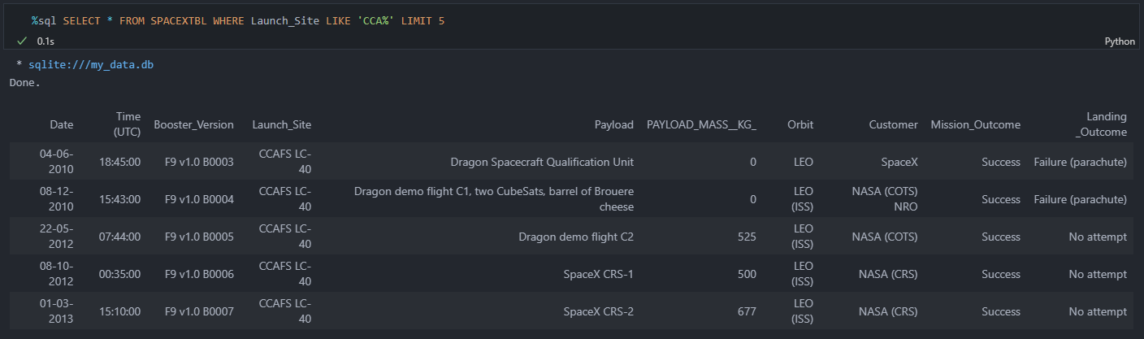
Launch Site Names Begin with 'CCA'

Slide 26
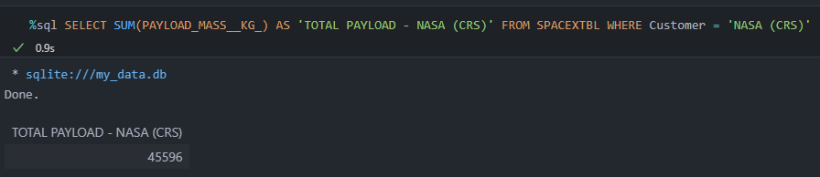
Total Payload Mass

Slide 27
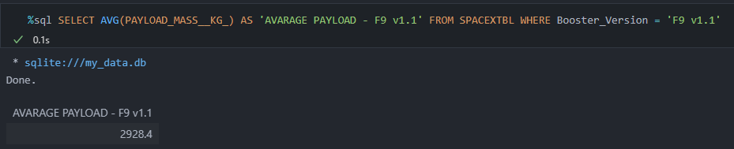
Average Payload Mass by F9 v1.1

Slide 28
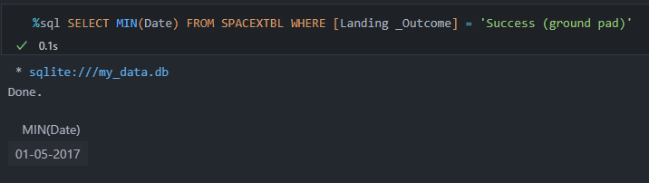
First Successful Ground Landing Date

Slide 29
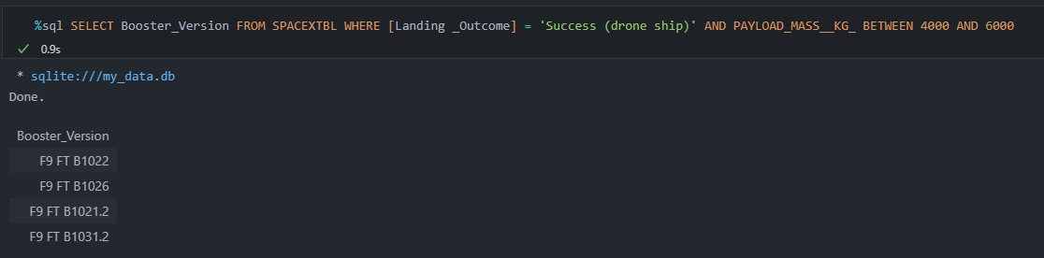
Successful Drone Ship Landing with Payload between 4000 and 6000

Slide 30
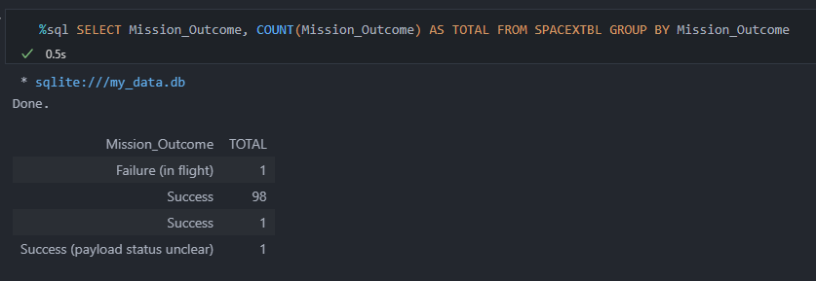
Total Number of Successful and Failure Mission Outcomes

Slide 31
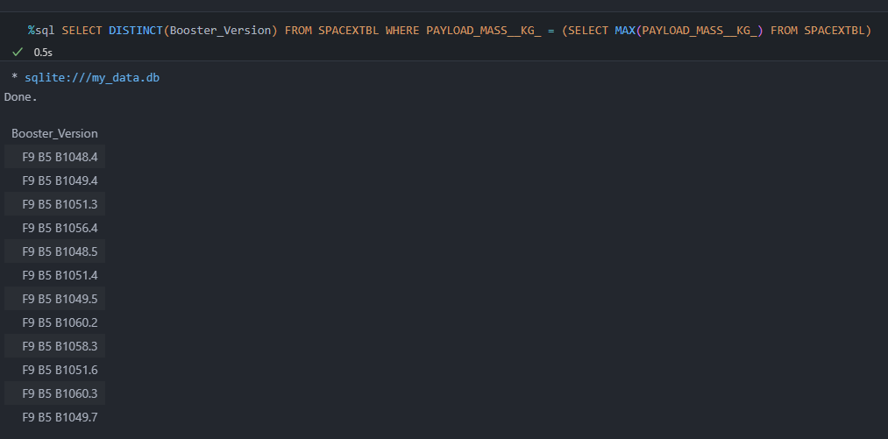
Boosters Carried Maximum Payload

Slide 32
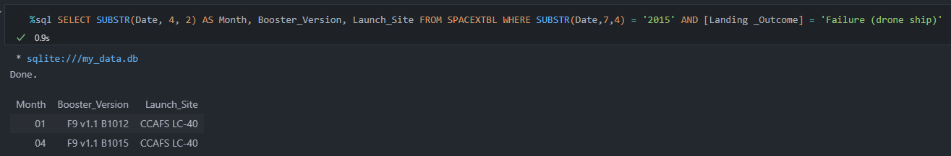
2015 Launch Records

Slide 33
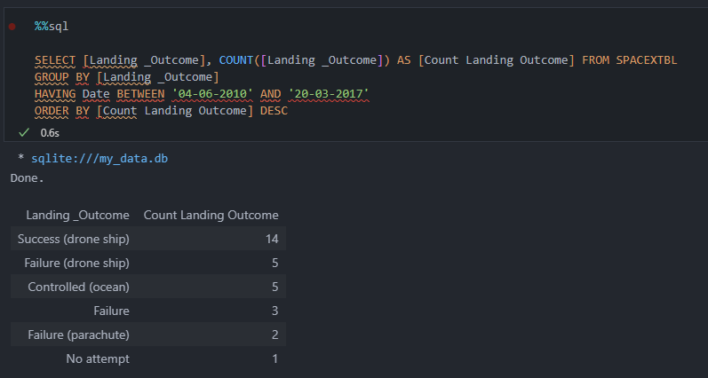
Rank Landing Outcomes Between 2010-06-04 and 2017-03-20

Slide 34

Section 3

Slide 35
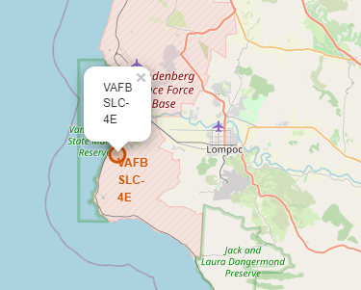
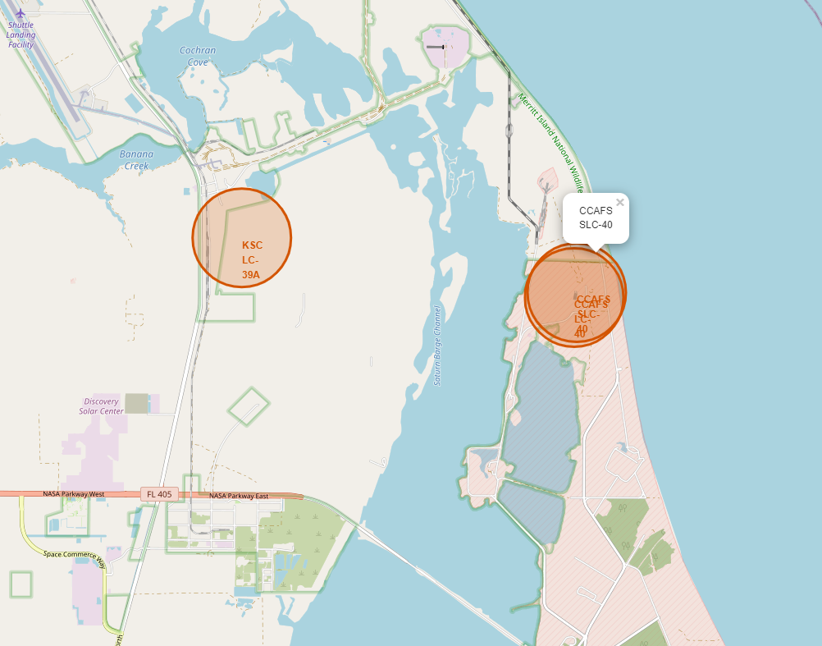
Launch Sites
California
Florida

Slide 36
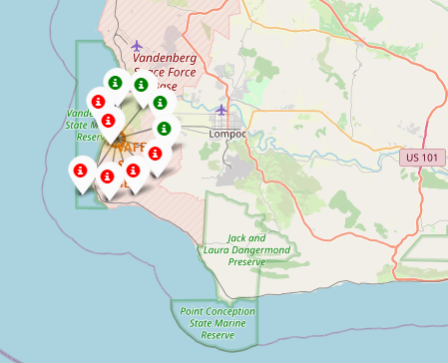
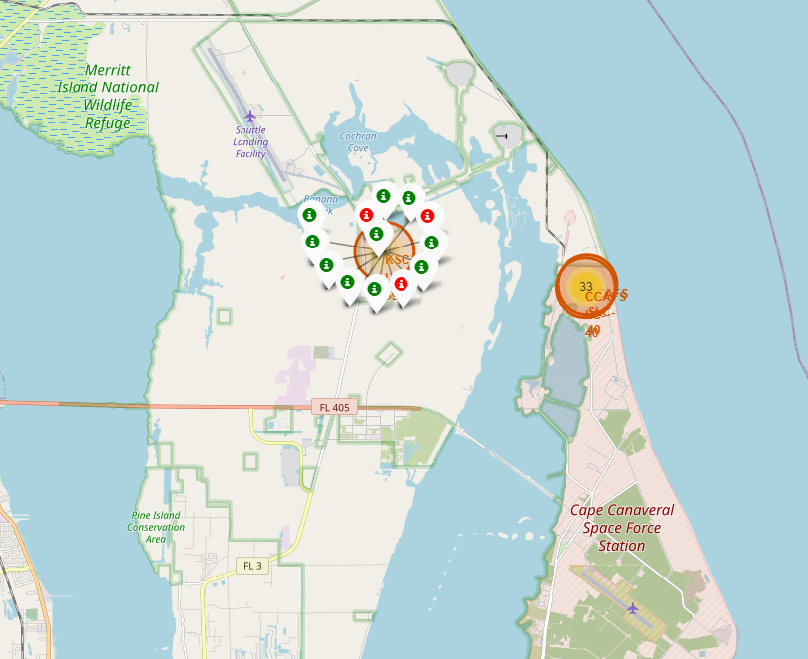
Launch Records
California
Florida

Slide 37
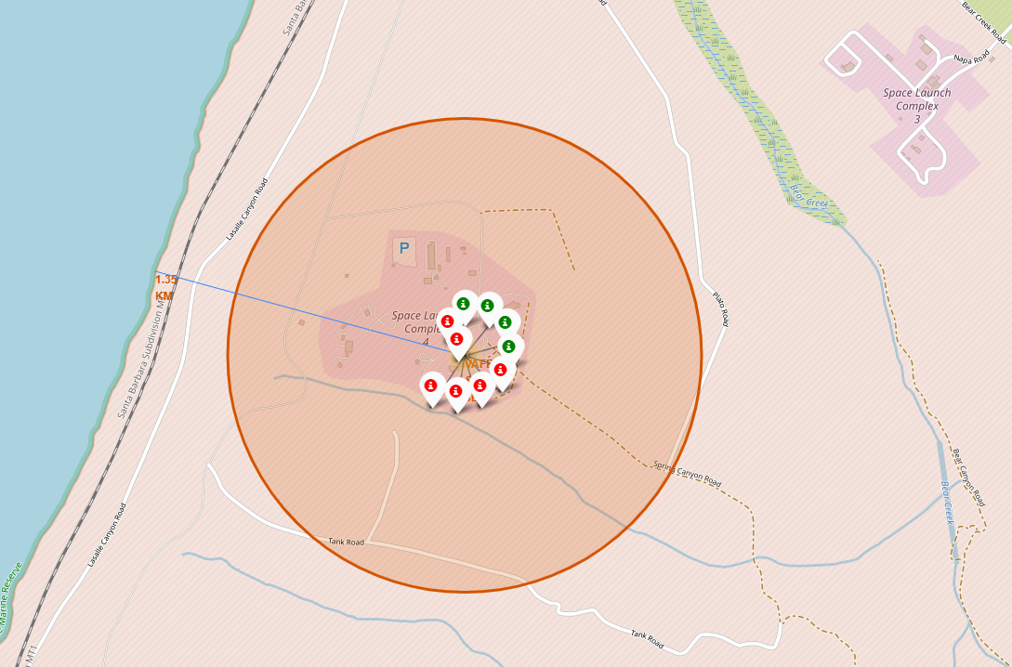
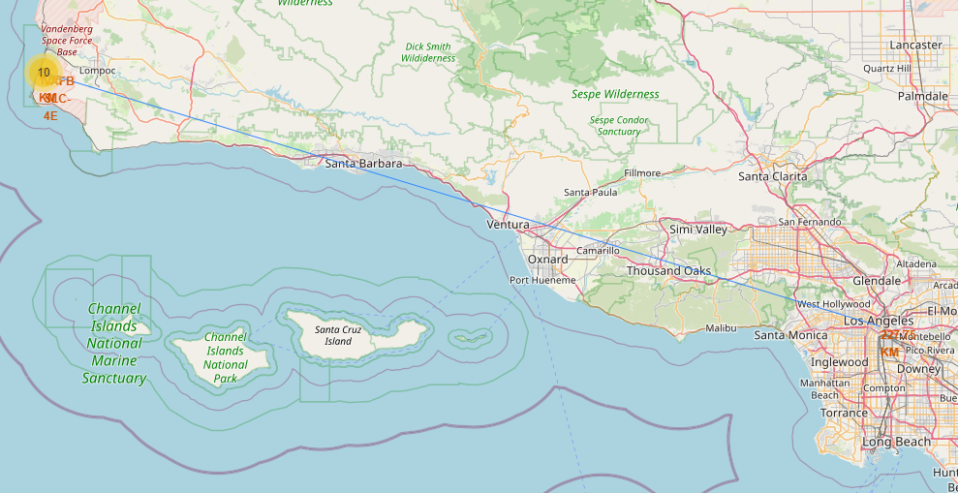
<Folium Map Screenshot 3>
1.35 KM to the coastline
227,75 KM to Los Angeles

Slide 38

Section 4

Slide 39
<Dashboard Screenshot 1>
Replace <Dashboard screenshot 1> title with an appropriate title
Show the screenshot of launch success count for all sites, in a piechart
Explain the important elements and findings on the screenshot

Slide 40
<Dashboard Screenshot 2>
Replace <Dashboard screenshot 2> title with an appropriate title
Show the screenshot of the piechart for the launch site with highest launch success ratio
Explain the important elements and findings on the screenshot

Slide 41
<Dashboard Screenshot 3>
Replace <Dashboard screenshot 3> title with an appropriate title
Show screenshots of Payload vs. Launch Outcome scatter plot for all sites, with different payload selected in the range slider
Explain the important elements and findings on the screenshot, such as which payload range or booster version have the largest success rate, etc.

Slide 42

Section 5

Slide 43
Classification Accuracy
Visualize the built model accuracy for all built classification models, in a bar chart
Find which model has the highest classification accuracy

Slide 44
Confusion Matrix
Show the confusion matrix of the best performing model with an explanation

Slide 45
Conclusions
Point 1
Point 2
Point 3
Point 4
…

Slide 46
Appendix
Include any relevant assets like Python code snippets, SQL queries, charts, Notebook outputs, or data sets that you may have created during this project

Slide 47


